Slide 1
Journey to the HR Dashboard
STAGE
STAGE
STAGE
STAGE
STAGE
01
02
03
04
05
Understand Customer Requirements
Collect requirements
Choose the right charts
Draw mockups
Choose the colors
Identify the Data Source
Connect the data
Cleanup the data
Create data model (when applicable)
Check data types
Build the Charts
Create calculations
Build each chart
Format the charts
Cleanup and prepare the charts
Build the Dashboard
Draw a dashboard mockup
Create container structure
Put all charts together
Format the dashboard
Add filters
Beautify the dashboard
Create file structure
Export the dashboard
Compress data files
Upload all files to Github
User Story - HR Dashboard
As an HR manager, I want a comprehensive dashboard to analyze human resources data, providing both summary views for high-level insights and detailed employee records for in-depth analysis.

Slide 2
Customer requirements
Display the total number of hired employees, active employees, and terminated employees.
Visualize the total number of hired and terminated employees over the years.
Present a breakdown of total employees by department and job titles.
Compare total employees between headquarters (HQ) and branches (New York is the HQ)
Show the distribution of employees by city and state.
Present the gender ratio in the company.
Visualize the distribution of employees across age groups and education levels.
Show the total number of employees within each age group.
Show the total number of employees within each education level.
Present the correlation between employees' educational backgrounds and their performance ratings.
Compare salaries across different education levels for both genders to identify any discrepancies or patterns.
Present how the age correlate with the salary for employees in each department.

Slide 3
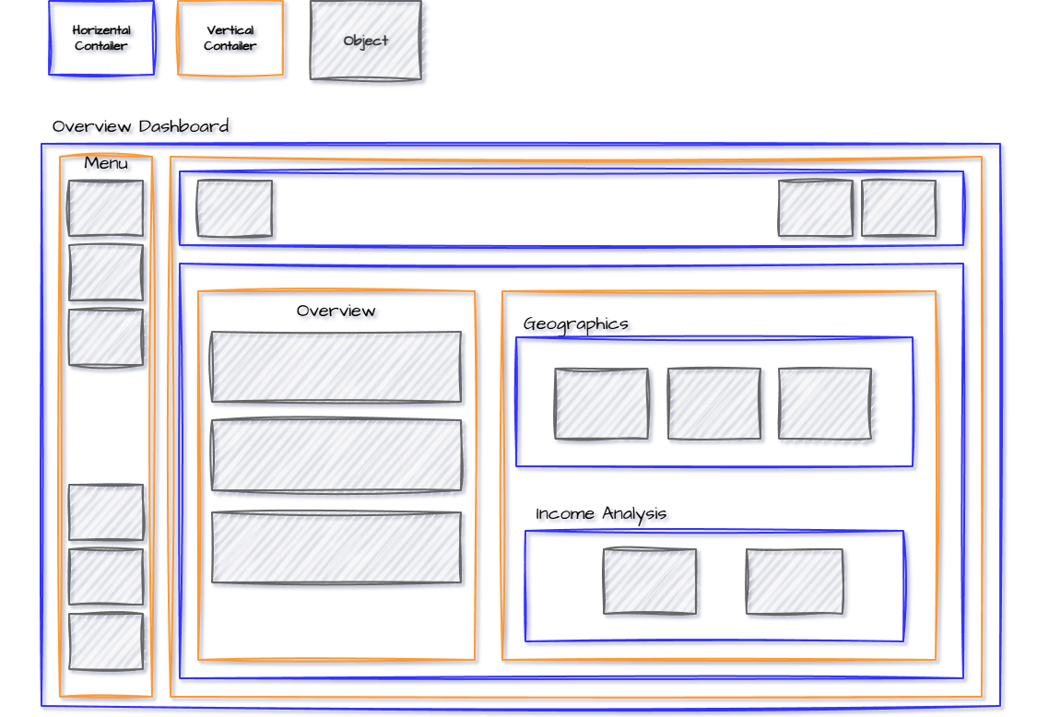
Dashboard Mockup – Overview Page

Slide 4
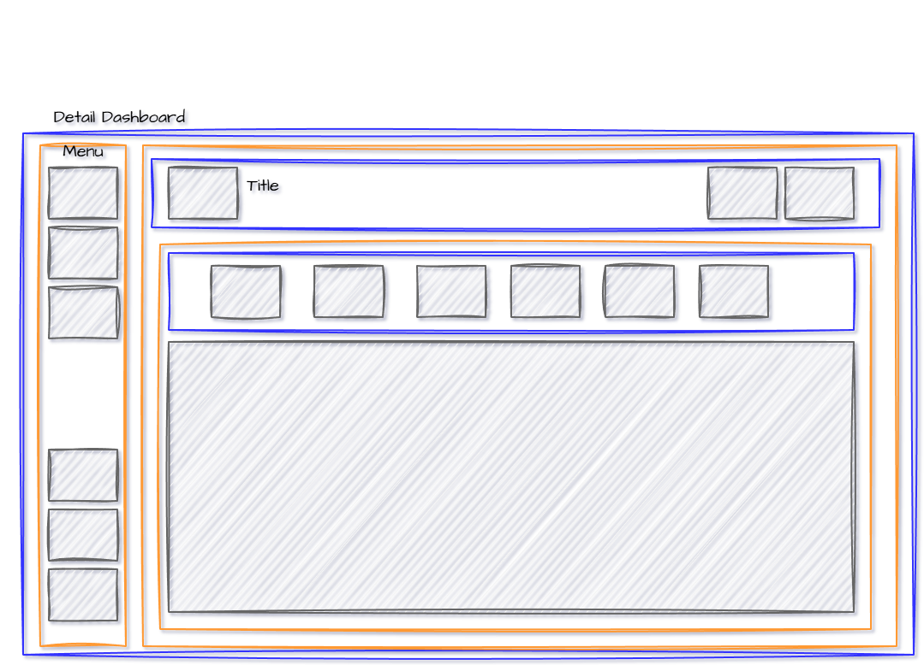
Dashboard Mockup – detail Page

